Slide 1

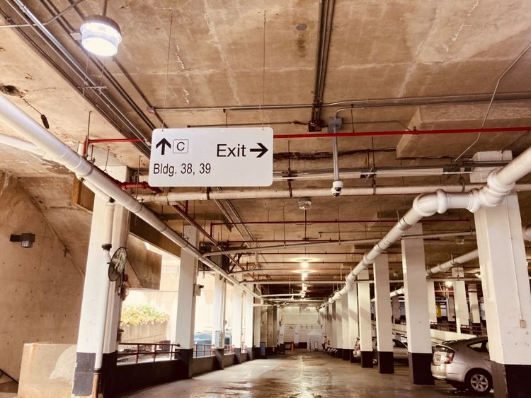
self service/Monitoring garage portal AKA: garage-k9 by: ahmed Hassan
University of the district of Columbia
Department of computer science & information technology
SPRING 2021

Slide 2
Introduction
One part of being a Software Engineer is to identify problems and create potential solutions for them. By doing so, we can simplify day to day tasks and innovate the way we do things.
Witnessing and experiencing the process of purchasing a parking pass at UDC seemed complex and outdated as it requires a few steps as well as having to visit multiple buildings and fill out handwritten forms. After looking back at these steps, last semester I proposed to develop a tool to act as an asset in simplifying and innovating this complex process for both students and staff.

Slide 3
Comparison
Disadvantages of Current Process
Garage-K9 Advantages
Requires human presence
Limited to office hours
Time consuming for students
Requires printed forms
Requires in-person payments
All-in-One Automated Solution for both staff and students.
Accessible
Electronic
Paperless
Contactless

Slide 4
Objective & Project Description
Garage-K9 is a self-service Web Application which simplifies the process of purchasing parking passes at UDC while assisting school officials in monitoring the garage in an effective digital way.
This tool is an asset to school officials in managing parking spaces at the garage. Hence, it will be manageable to distinguish between a student’s car, and those who are coming from the outside to use this public parking.
It will also assist in solving the issues of unknown vehicles that are parked overnight or in spaces which they are not allowed to.
School officials can quickly identify a student’s vehicle, send alerts in case of emergencies as needed. This is done by searching into a database using the vehicle’s license plate number, then the vehicle’s information as well as its owner’s contact information is provided.

Slide 5





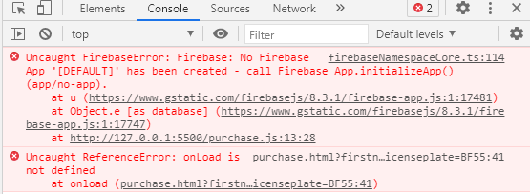
Foundation & TOOLS utilized

Slide 6
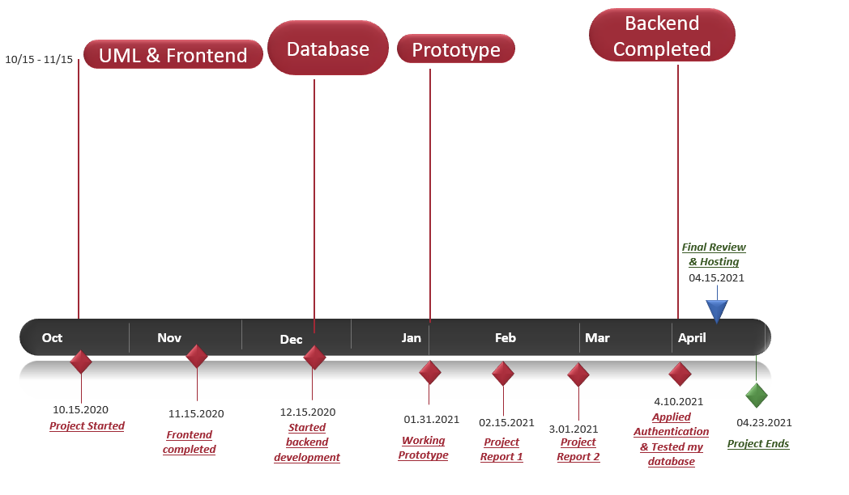
Timeline

Slide 7
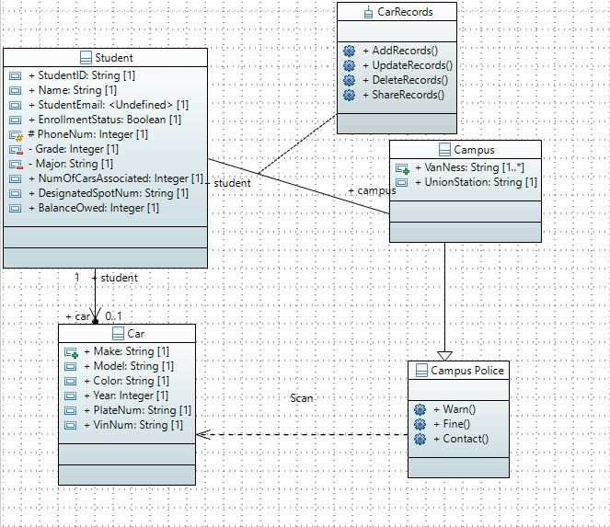
UML Diagram

Slide 8
Structure & FUNCTIONS
Admin Login
Student Login
Look Up Vehicle
Search using License Plate Number
LOOKUP VEHICLE
Student Records
+ADD
DELETE
+Vehicle Information
+Student Contact Information
+SEARCH
By “N Number”
UPDATE
- ONLY VEHICLE INFO
Purchase Parking Pass
Authentication Required
Submitted
Anonymously
Contact
Authentication Not Required
- Contact information
+Student Information
+Vehicle information
Checkout
-Bill Me on Student Account
-Pay Now
+Incident date
+Subject
+Message
+Attach pictures
Submit Incident
Send Message
Report Incident

Slide 9
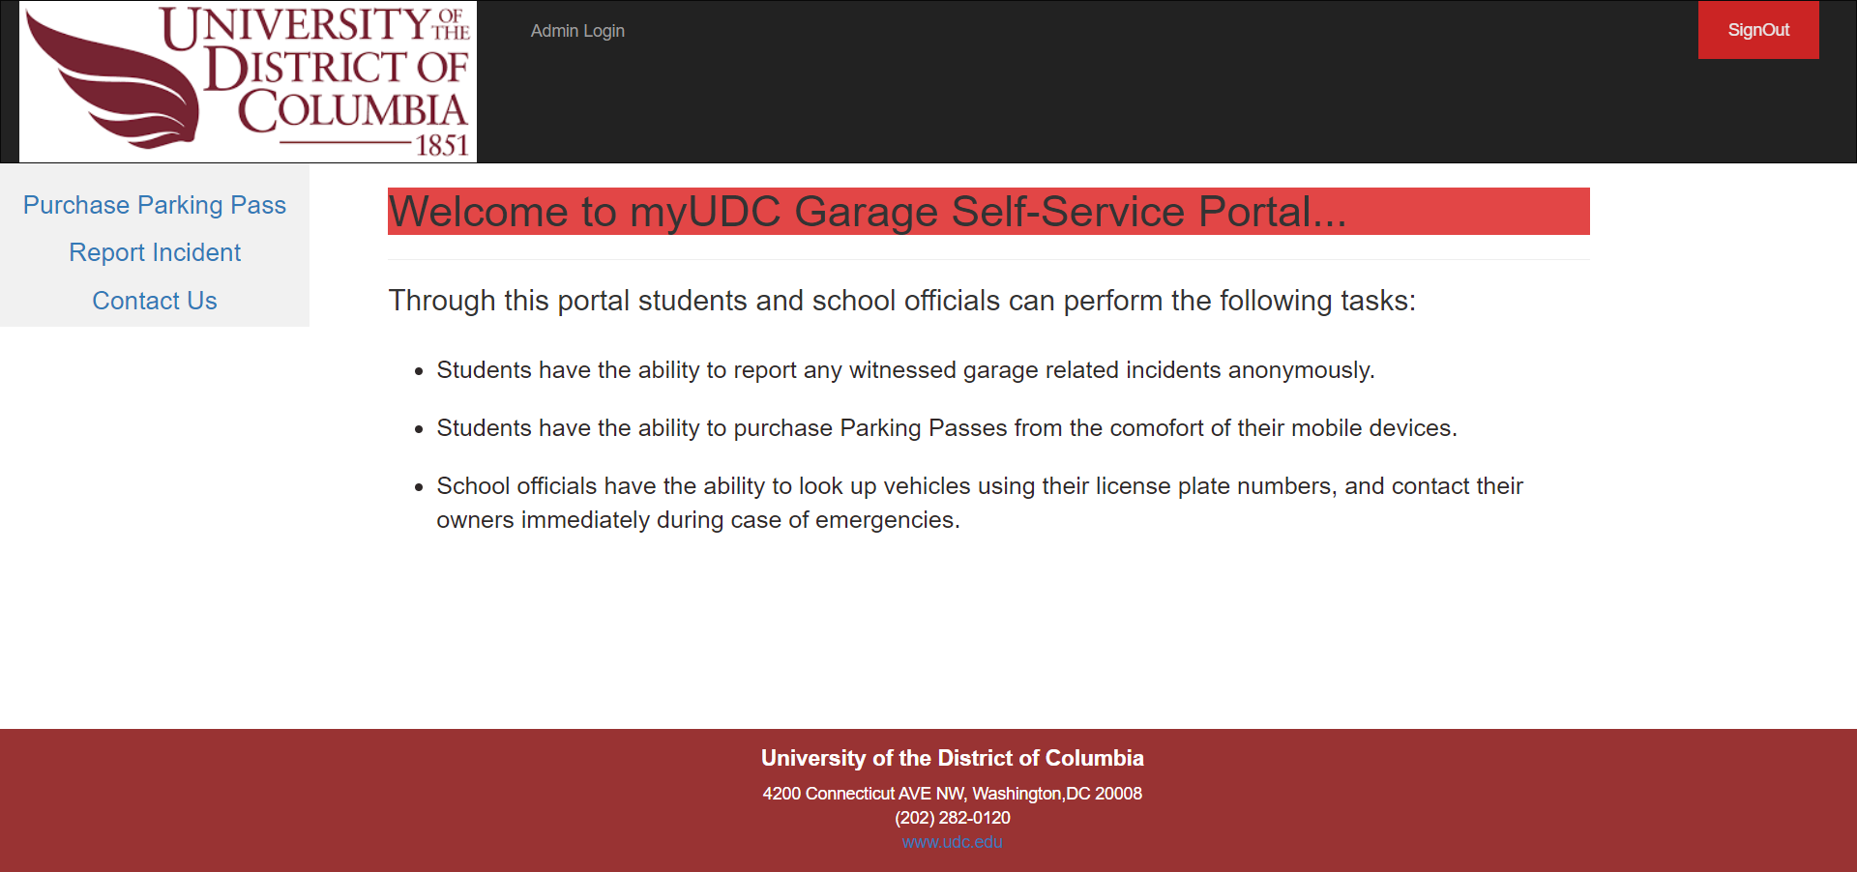
Homepage- Student view

Slide 10
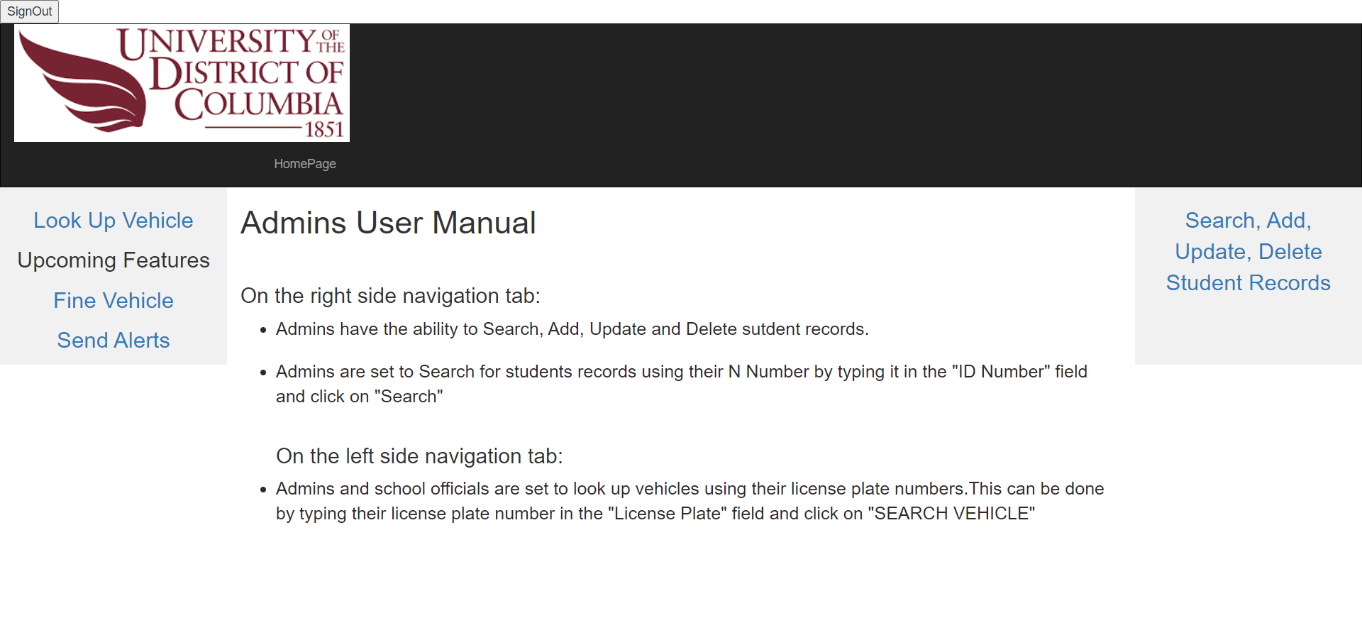
Admin view

Slide 11
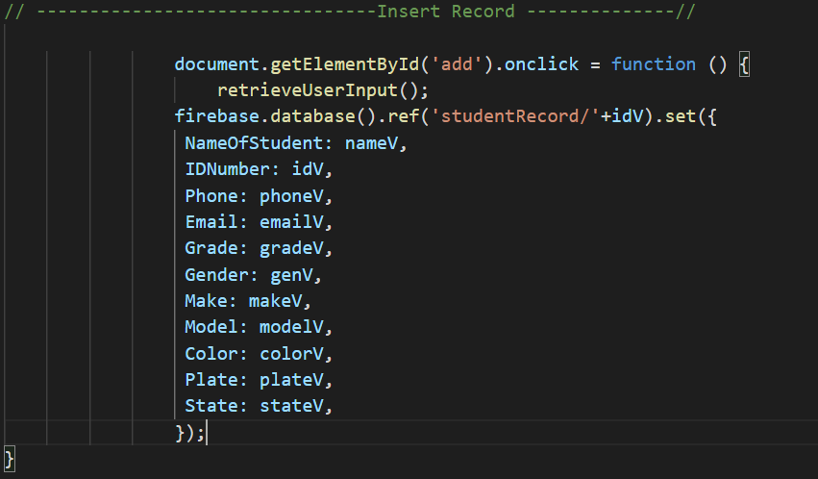
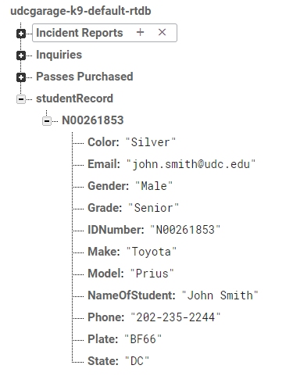
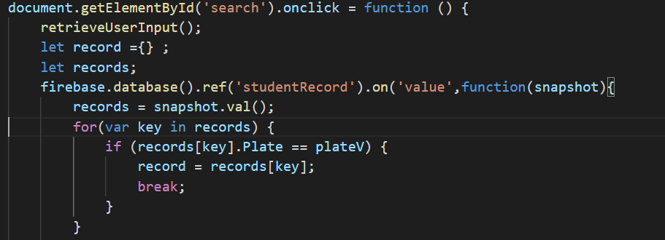
Adding and searching for record using firebase

Slide 12
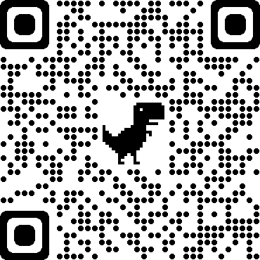
Hosting & Demo
https://udcgarage-k9.web.app
Portal is now live on a secure domain.
Easily accessible via mobile devices.
Looking to purchase parking Pass ?
SCAN ME to get started!

Slide 13
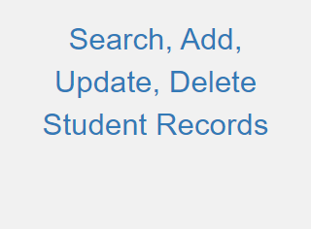
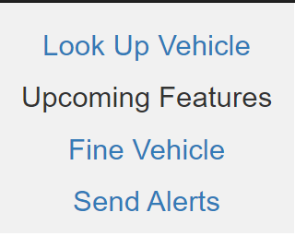
Future enhancements and upcoming Features
Warn/Fine Vehicle
- License Plate ex: BF66
- Fine Amount ex: $50
- Reason for fine:
parking in a handicap spot.
Parking in a reserved spot.
Parking after hours without required permit.
Other:
Send Alerts
Sending Alerts via emails and text messages
QR CODES
As students purchase their parking pass, they would receive a confirmation email that contains a pdf attachment which would include a QR code that they can print and place on their car’s windshield.

Slide 14
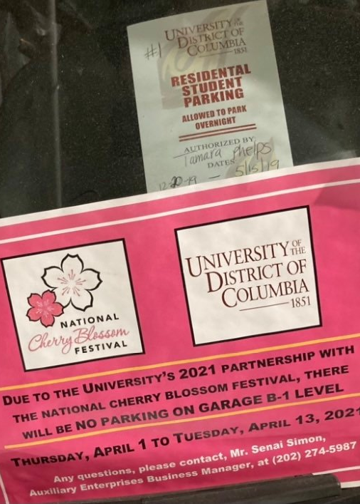
Conclusion
This Web Application can assist the school in becoming paperless when it gets to dealing with parking passes. For example, the pass in the picture on the left side would no longer be needed. Instead, students will be provided with QR Codes via email designated to them which will be associated and linked to their N# throughout their time at UDC.
This is a more effective way of distributing parking passes to students and keeping track of them.
Easily contact students in case of emergencies, and fine those who violate the garage rules.

Slide 15
Thank you Any Questions or feedback ?
Ahmed Hassan
ahmedsabry.hassan@udc.edu

